Slide 1
Complexity of conventional Sorting Algorithms
Course Code: CSC2211
Course Title: Algorithms
Dept. of Computer Science
Faculty of Science and Technology
Lecturer No: | 4.1 | Week No: | 04 | Semester: | Spring 22-23
Lecturer: | Pritam Khan Boni; pritam.khan@aiub.edu

Slide 2
Lecture Outline
1. Sorting Algorithms
Quick Sort

Slide 3
Quick Sort
Quick sort is based on the divide-and-conquer approach.
The idea is based on of choosing one element as a pivot element and partitioning the array around it such that:
Left side of pivot contains all the elements that are less than the pivot element.
Right side contains all elements greater than the pivot.
It reduces the space complexity and removes the use of the auxiliary array that is used in merge sort.
Selecting a random pivot in an array results in an improved time complexity in most of the cases.

Slide 4
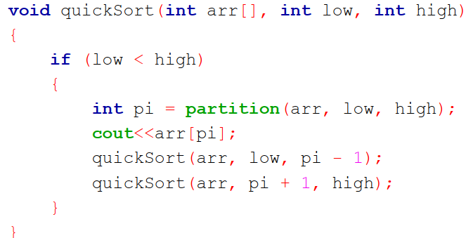
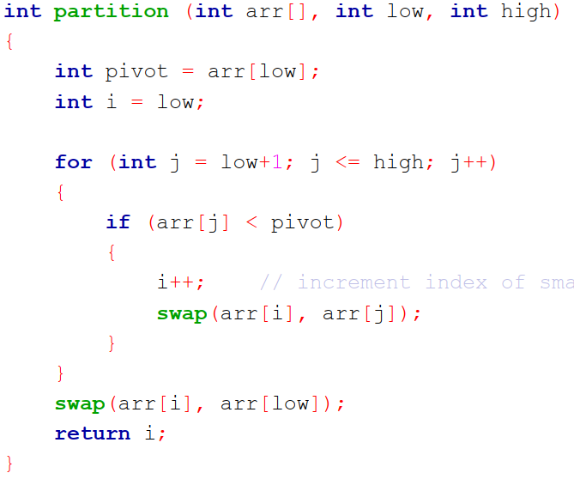
Quick Sort Algorithm

Slide 5
Quicksort
A divide & conquer algorithm
Efficient sorting algorithm
Discovered by C.A.R. Hoare
Basic idea:
Pick an element (called pivot)
Partition the array in two subsequences: those smaller than the pivot and those larger or equal: Divide
Sort each subsequence recursively: Conquer

Slide 6
Quicksort: Partitioning an array
Goal
Move all elements smaller than or equal to the pivot to the left of the array and all elements larger than or equal to the pivot to the right of the array. In the end, the right part of the array will contain elements that are larger than or equal to those in the left part.
Choosing the pivot is crucial
< pivot
pivot
> pivot

Slide 7
Quicksort
Place the pivot in its appropriate position
Recursively the same algorithm is applied to each part
Until there is only single element i.e., no way to divide in two part
< pivot
> pivot
< pivot1
pivot1
> pivot1
pivot
< pivot2
pivot2
> pivot2

Slide 8
Quicksort: Code
void quicksort( int *a, int low, int high )
{
int pivot;
/* Termination condition! */
if ( high > low )
{
pivot = partition( a, low, high );
quicksort( a, low, pivot-1 );
quicksort( a, pivot+1, high );
}
}

Slide 9
int partition( int *a, int low, int high )
{
int left, right, pivot_item;
pivot_item = a[low];
pivot = left = low;
right = high;
while ( left < right )
{
/* Move left while item < pivot */
while( a[left] <= pivot_item )
left++;
/* Move right while item > pivot */
while( a[right] >= pivot_item )
right--;
if ( left < right )
SWAP(a[left],a[right]);
}
/* Right is final position for the pivot */
a[low] = a[right];
a[right] = pivot_item;
return right;
}

Slide 10
Quicksort: Way of Execution
pivot_item = a[low];
Any item will do as the pivot,
choose the leftmost one!
23
12
15
38
42
18
36
29
27
low
high

Slide 11
Quicksort: Way of Execution
pivot = left = low;
Set left and right markers
right = high;
left
right
23
12
15
38
42
18
36
29
27
low
pivot: 23
high

Slide 12
Quicksort: Way of Execution
Move the markers
until they cross over
while ( left <= right ) {
left++;
right--;
left
right
23
12
15
38
42
18
36
29
27
low
pivot: 23
high

Slide 13
Quicksort: Way of Execution
Move the left pointer while
it points to items <= pivot
while( a[left] <= pivot_item )
left++;
left
23
12
15
38
42
18
36
29
27
low
pivot: 23
high

Slide 14
Quicksort: Way of Execution
Move the left pointer while
it points to items <= pivot
while( a[left] <= pivot_item )
left++;
left
23
12
15
38
42
18
36
29
27
low
pivot: 23
high

Slide 15
Quicksort: Way of Execution
Move the left pointer while
it points to items <= pivot
while( a[left] <= pivot_item )
left++;
left
23
12
15
38
42
18
36
29
27
low
pivot: 23
high

Slide 16
Quicksort: Way of Execution
Move the left pointer while
it points to items <= pivot
while( a[left] <= pivot_item )
left++;
left
23
12
15
38
42
18
36
29
27
low
pivot: 23
high

Slide 17
Quicksort: Way of Execution
Move the right pointer while
it points to items >= pivot
while( a[right] >= pivot_item )
right--;
left
right
23
12
15
38
42
18
36
29
27
low
pivot: 23
high

Slide 18
Quicksort: Way of Execution
Move the right pointer while
it points to items >= pivot
while( a[right] >= pivot_item )
right--;
left
right
23
12
15
38
42
18
36
29
27
low
pivot: 23
high

Slide 19
Quicksort: Way of Execution
Move the right pointer while
it points to items >= pivot
while( a[right] >= pivot_item )
right--;
left
right
23
12
15
38
42
18
36
29
27
low
pivot: 23
high

Slide 20
Quicksort: Way of Execution
Move the right pointer while
it points to items >= pivot
while( a[right] >= pivot_item )
right--;
left
right
23
12
15
38
42
18
36
29
27
low
pivot: 23
high

Slide 21
Quicksort: Way of Execution
Move the left pointer while
it points to items <= pivot
while( a[left] <= pivot_item )
left++;
while( a[right] >= pivot_item )
right--;
left
right
Move right
similarly
23
12
15
38
42
18
36
29
27
low
pivot: 23
high

Slide 22
Quicksort: Way of Execution
Swap the two items
on the wrong side of the pivot
if ( left < right )
SWAP(a[left], a[right]);
left
right
23
12
15
18
42
38
36
29
27
pivot: 23
low
high

Slide 23
Quicksort: Way of Execution
Swap the two items
on the wrong side of the pivot
if ( left < right )
SWAP(a[left], a[right]);
left
right
23
12
15
18
42
38
36
29
27
pivot: 23
low
high

Slide 24
Quicksort: Way of Execution
while ( left < right ) {
while( a[left] <= pivot_item )
left++;
left
right
23
12
15
18
42
38
36
29
27
low
high
pivot: 23

Slide 25
Quicksort: Way of Execution
while ( left < right ) {
while( a[left] <= pivot_item )
left++;
left
right
23
12
15
18
42
38
36
29
27
low
high
pivot: 23

Slide 26
Quicksort: Way of Execution
while ( left < right ) {
while( a[right] >= pivot_item )
right--;
left
right
23
12
15
18
42
38
36
29
27
low
high
pivot: 23

Slide 27
Quicksort: Way of Execution
while ( left < right ) {
while( a[right] >= pivot_item )
right--;
left
right
23
12
15
18
42
38
36
29
27
low
high
pivot: 23

Slide 28
Quicksort: Way of Execution
right
left
23
12
15
18
42
38
36
29
27
low
pivot: 23
high
a[low] = a[right];
a[right] = pivot_item;
Finally, swap the pivot
and right

Slide 29
Quicksort: Way of Execution
right
pivot: 23
18
12
15
23
42
38
36
29
27
low
high
Return the position
of the pivot
return right;

Slide 30
Quicksort: Way of Execution
pivot
pivot: 23
18
12
15
23
42
38
36
29
27
Recursively
sort left half
Recursively
sort right half
Conquer

Slide 31
Quicksort
23
12
15
38
42
18
36
29
27
18
12
15
42
38
36
29
27
23
38
36
29
27
42
12
15
18
36
29
27
38
12
15
29
27
36
27
29
12
15
18
23
27
29
36
38
42

Slide 32
Quick Sort Analysis
Substitution Method

Slide 33
Quicksort: Analysis
Running time: depends on selection of pivot
Best case (array partitioned in half every time)
O(n log n)

Slide 34
int partition( int *a, int low, int high ) { int left, right, pivot_item; pivot_item = a[low]; pivot = left = low; right = high; while ( left < right ) { /* Move left while item < pivot */ while( a[left] <= pivot_item ) left++; /* Move right while item > pivot */ while( a[right] >= pivot_item ) right--; if ( left < right ) SWAP(a[left],a[right]); } /* Right is final position for the pivot */ a[low] = a[right]; a[right] = pivot_item; return right; } | c1 + c2* (n/2) + c2* (n/2) =c2( n/2 + n/2) =c2 * n

Slide 35
Best Case | T(n), to sort n elements
void quicksort( void *a, int low, int high ) { int pivot; /* Termination condition! */ if ( high > low ) { | c1
pivot = partition( a, low, high ); | c2 * n
quicksort( a, low, pivot-1 ); | T(n/2)
quicksort( a, pivot+1, high ); | T(n/2)
} }
So, T(n) = O(1) when n = 1, and 2T(n/2) + c1+ c2*n when n > 1

Slide 36
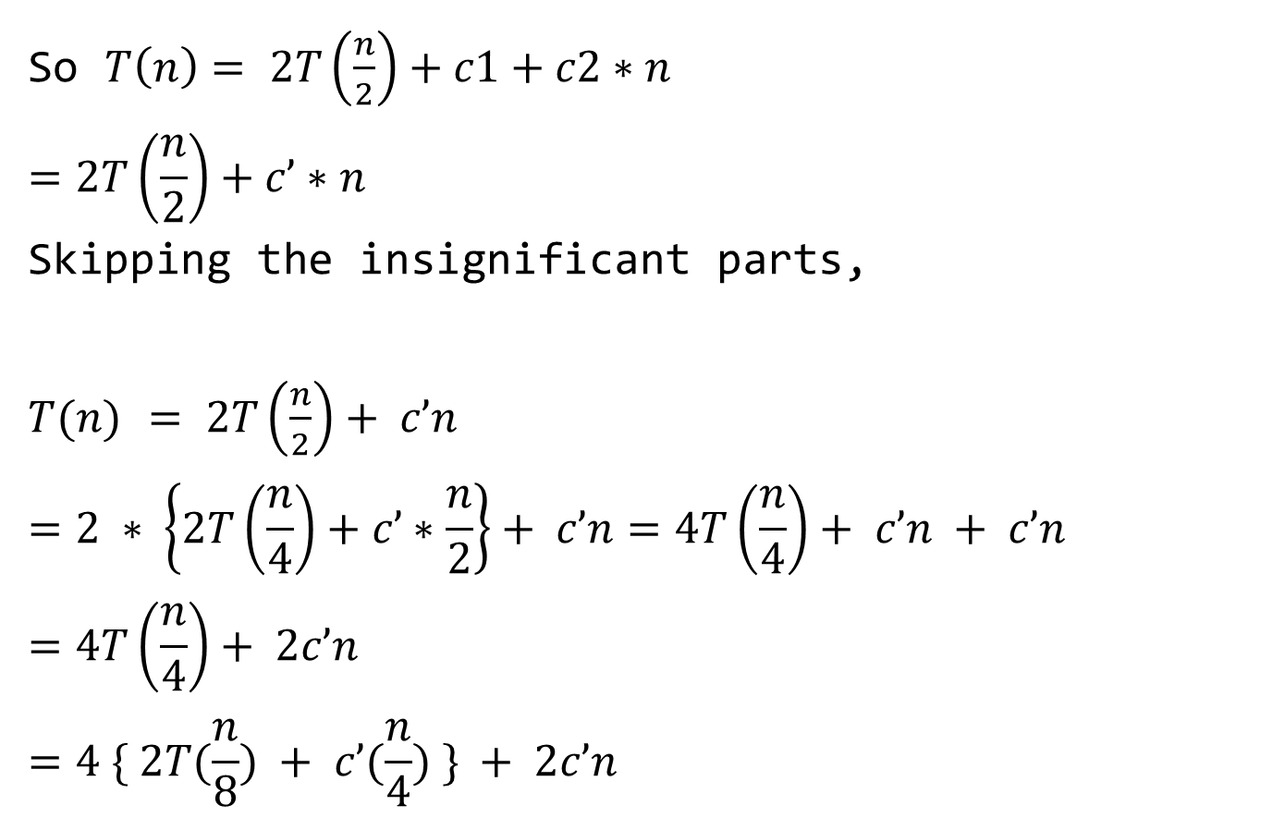
So $T\left(n\right)= 2T\left(\frac{n}{2}\right)+c1+c2∗n$
$$=2T\left(\frac{n}{2}\right)+c’∗n$$
Skipping the insignificant parts,
$T(n)$ $= 2T\left(\frac{n}{2}\right)+ c’n$
$$=2 ∗ \left\{2T\left(\frac{n}{4}\right)+c’∗\frac{n}{2}\right\}+ c’n=4T\left(\frac{n}{4}\right)+ c’n + c’n$$
$$=4T\left(\frac{n}{4}\right)+ 2c’n$$
$$=4 \{ 2T(\frac{n}{8}) + c’(\frac{n}{4}) \} + 2c’n$$

Slide 37
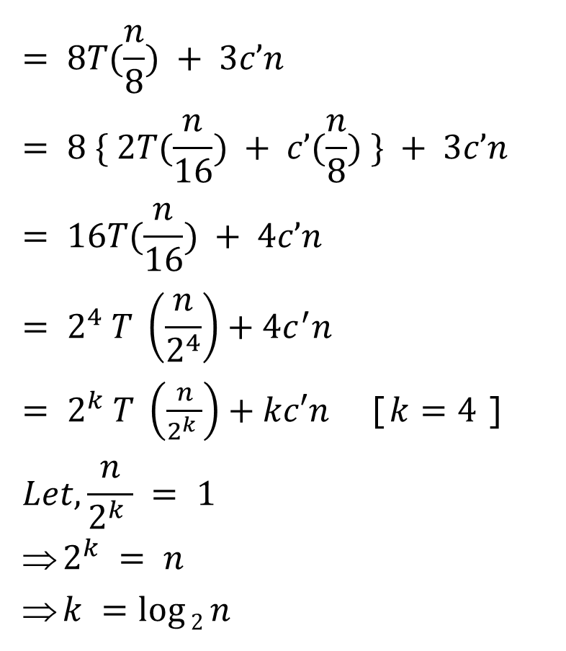
$$= 8T(\frac{n}{8}) + 3c’n$$
$$= 8 \{ 2T(\frac{n}{16}) + c’(\frac{n}{8}) \} + 3c’n= 16T(\frac{n}{16}) + 4c’n$$
$$= 2^{4} T \left(\frac{n}{2^{4}}\right)+4c^{′}n$$
$= 2^{k} T \left(\frac{n}{2^{k} }\right)+kc′n$ [$k=4$]
$$Let, \frac{n}{2^{k} } = 1$$
$2^{k} = n$
$k =\log{2}n$

Slide 38
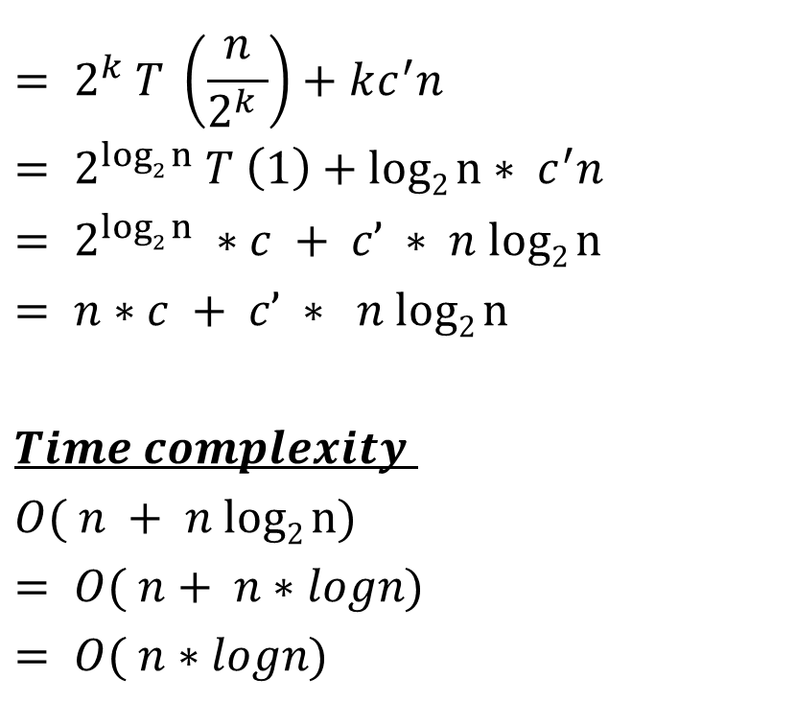
$$= 2^{k} T \left(\frac{n}{2^{k} }\right)+kc^{′}n$$
$$= 2^{log2 n} T \left(1\right)+log2 n∗ c^{′}n$$
$$= 2^{log2 n} ∗c + c’ ∗ n log2 n= n∗c + c’ ∗ n log2 n$$
$$Time complexity$$
$$O( n + n log2 n)$$
$$= O( n+ n∗logn)$$
$$= O( n∗logn)$$

Slide 39
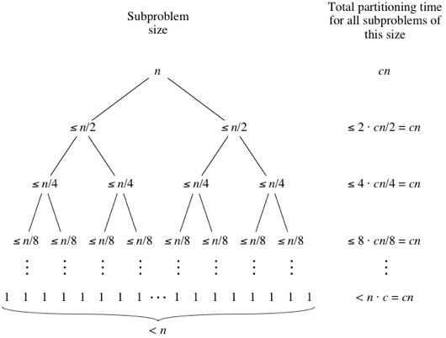

Slide 40
Quicksort: Analysis
Worst case:
Partitioning n elements results in two subsequences of lengths 1 and n-1
What happens if we use quicksort on data that’s already sorted (or nearly sorted)?
Now Take a look

Slide 41
Quicksort: Analysis
Sorted Data
pivot
?
1
2
3
4
5
6
7
8
9
< pivot
> pivot

Slide 42
Quicksort: Analysis (Sorted Data)
Each partition produces
a problem of size 0
and one of size n-1!
pivot
1
2
3
4
5
6
7
8
9
> pivot
pivot
2
3
4
5
6
7
8
9
> pivot

Slide 43
Worst Case | T(n), to sort n elements
void quicksort( void *a, int low, int high ) { int pivot; /* Termination condition! */ if ( high > low ) { | c1
pivot = partition( a, low, high ); | c2 * n
quicksort( a, low, pivot-1 ); | T(1) = c3
quicksort( a, pivot+1, high ); | T(n-1)
} }
So, T(n) = O(1) when n = 1, and T(n-1) + c1+ c2*n + c3 when n > 1

Slide 44

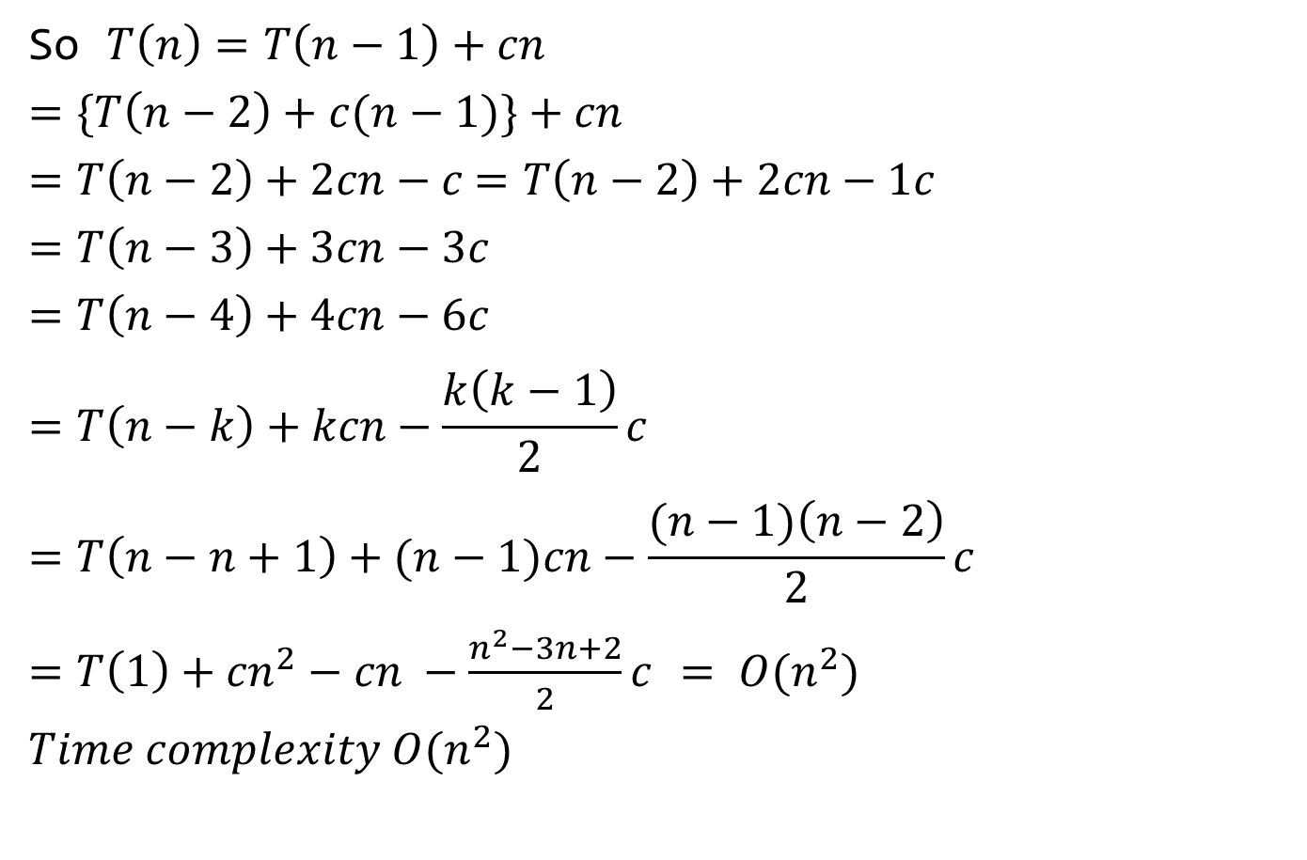
So $T\left(n\right)=T\left(n−1\right)+cn$
$$=\{T\left(n−2\right)+c(n−1)\}+cn$$
$=T\left(n−2\right)+2cn−c$ $=T\left(n−2\right)+2cn−1c$
$$=T\left(n−3\right)+3cn−3c$$
$$=T\left(n−4\right)+4cn−6c$$
$$=T\left(n−k\right)+kcn−\frac{k\left(k−1\right)}{2}c$$
$$=T\left(n−n+1\right)+(n−1)cn−\frac{(n−1)\left(n−2\right)}{2}c$$
$=T\left(1\right)+{cn}^{2}−cn −\frac{n^{2}−3n+2}{2}c$ $= O(n^{2})$
$$Time complexity O(n^{2})$$
n – k = 1
k = n - 1
0, 1, 3, 6
= 0, 1, (1+2), (1+2+3)
Kth term
1+2+3+....+(k-1) = $\frac{k(k−1)}{2}$

Slide 45
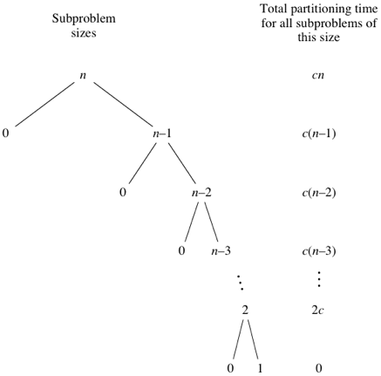

Slide 46
Quicksort: Improve performance
Quicksort’s O(n log n) behavior
Depends on the partitions being nearly equal
there are O( log n ) of them
On average, this will nearly be the case
and quicksort is generally O(n log n)
Can we do anything to ensure O(n log n) time?
In general, no
But we can improve our chances!!

Slide 47
Quicksort: How to select pivot?
Any pivot will work …
But choose a different pivot …
So that the partitions are equal
Then we will see O(n log n) time
pivot
1
2
3
4
5
6
7
8
9
> pivot
< pivot

Slide 48
Quicksort: How to select pivot? Median-of-3 pivot
Take 3 positions and choose the median
Say … First, middle, last
Median is 5
Perfect division of sorted data every time!
O(n log n) time
Since sorted (or nearly sorted) data is common, median-of-3 is a good strategy
especially if you think your data may be sorted!
1
2
3
4
5
6
7
8
9

Slide 49
Quicksort: How to select pivot? Randomly selected pivot
Choose a pivot randomly
Different position for every partition
On average, sorted data is divided evenly
O(n log n) time
Key requirement
Pivot choice must take O(1) time

Slide 50
Quicksort: Guaranteed O (nlogn)
Never!!
Any pivot selection strategy could lead to O(n²) time
Here median-of-3 chooses 2
One partition of size 1 and
One partition of size 7
Next it chooses 4
One partition of size 1 and
One partition of size 5
1
4
9
6
2
5
7
8
3
1
2
4
9
6
5
7
8
3

Slide 51
Key points
Quicksort
O(n log n) but ….
Can be O(n²)
Depends on pivot selection
Median-of-3
Random pivot
Better but not guaranteed

Slide 52
Books
Introduction to Algorithms, Thomas H. Cormen, Charle E. Leiserson, Ronald L. Rivest, Clifford Stein (CLRS).
Fundamental of Computer Algorithms, Ellis Horowitz, Sartaj Sahni, Sanguthevar Rajasekaran (HSR)

Slide 53
References
https://www.google.com/search?q=bubble+sort+step+by+step&sxsrf=ALeKk01uxzgfT3Oy6k1Q3WxVnSpiIN8_4g:1587999728942&tbm=isch&source=iu&ictx=1&fir=vRwFsGwVfJ6pJM%253A%252CSzhhze6MPQr4cM%252C_&vet=1&usg=AI4_-kSrEEXqwRL-PkHhVUtn7jNfF9dB6g&sa=X&ved=2ahUKEwje0Pz974jpAhXRAnIKHWhMD2UQ_h0wAXoECAcQBg#imgrc=EN4Sdu7veOWVoM&imgdii=eOqvCu85p9-eBM
https://www.interviewcake.com/concept/java/counting-sort
https://www.geeksforgeeks.org/counting-sort/
https://www.hackerearth.com/practice/algorithms/sorting/quick-sort/tutorial/

